Slide 1
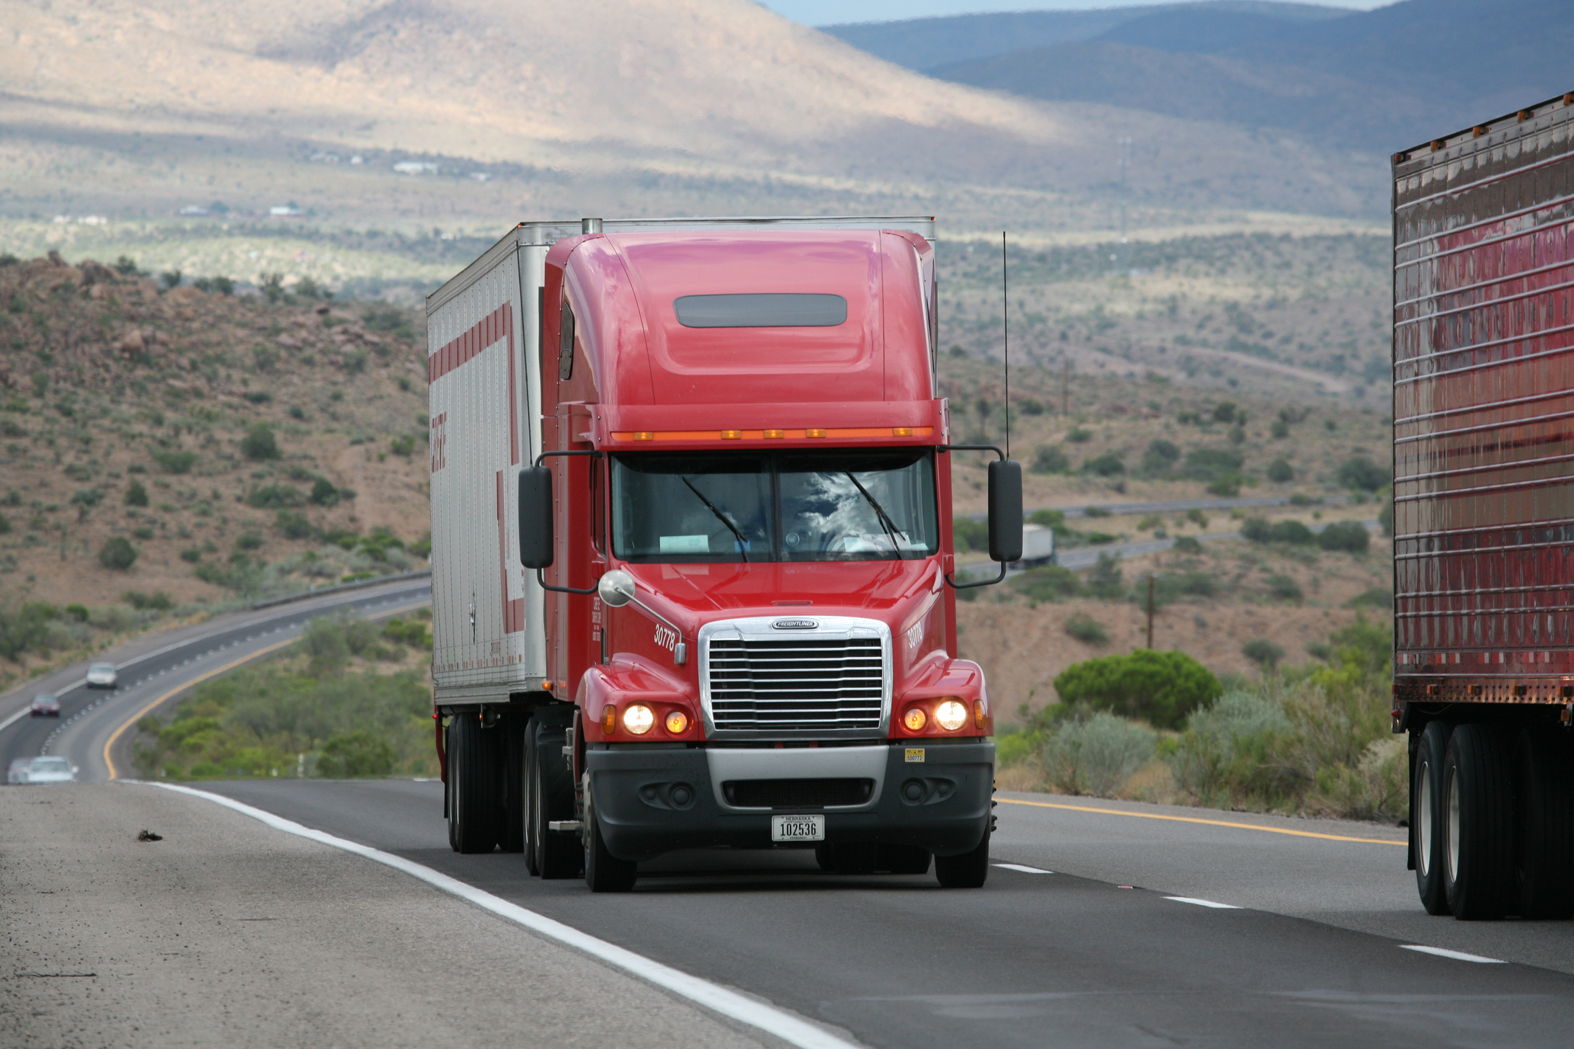




ANT TRUCKS
SAFE WHEELS
Ensuring Safety and Compliance at ANT
Group 9
Saranya Venkata Sai Mylavarapu
Nagpritam Pradeep Naik
Mounish Chowdary Nannuri
Premamaheswara Reddy Pappireddy
Akash Ramamurthy
Mahadevan Ramanan

Slide 2
PROJECT INTRODUCTION
Accidents caused by large trucks are a significant concern in the United States. Az National Trucking (ANT) aims to mitigate risks associated with trucking operations by identifying drivers exhibiting high-risk behaviors. The organization seeks to ensure compliance with regulations, enhance safety measures, and reduce insurance risks.
OBJECTIVES
Identify drivers with risk factors of 7.0 or higher to trigger alerts to management and insurance and analyze trucking data to visualize driver risk levels for informed decision-making.
Strengthen adherence to FMCSA regulations and internal policies to elevate safety standards across the fleet.

Slide 3
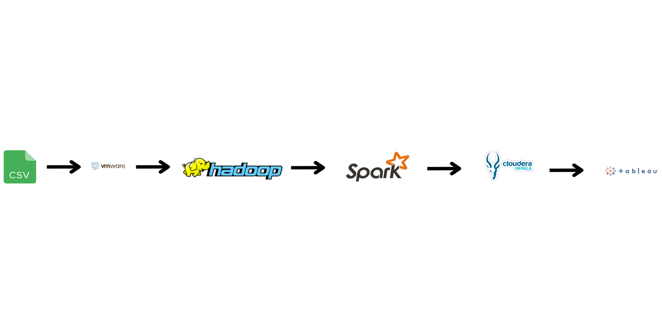
DATA PROCESSING

Slide 4
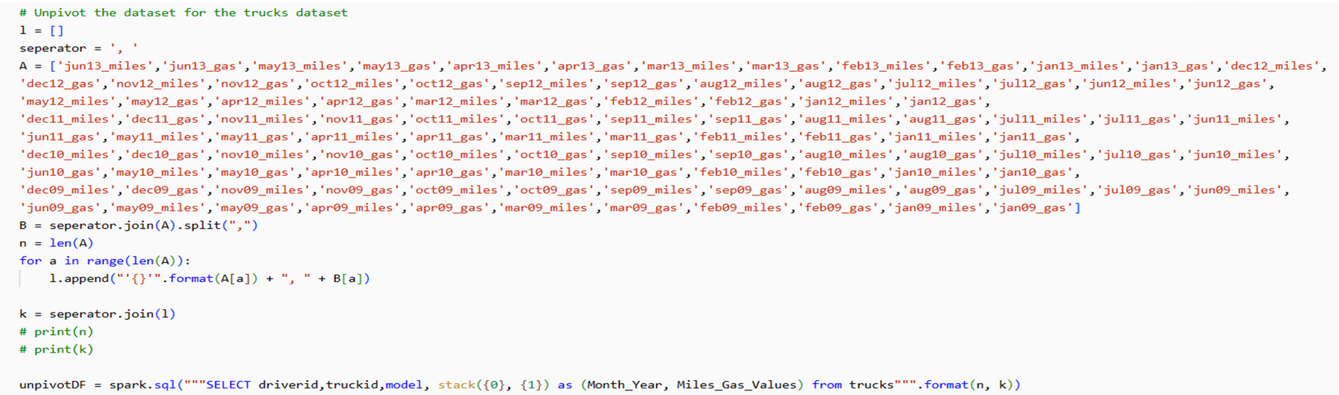

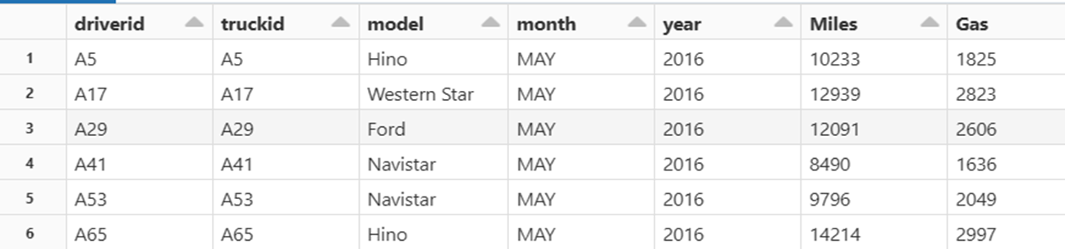
SOME SPARK TRANSFORMATIONS
OUTPUT

Slide 5
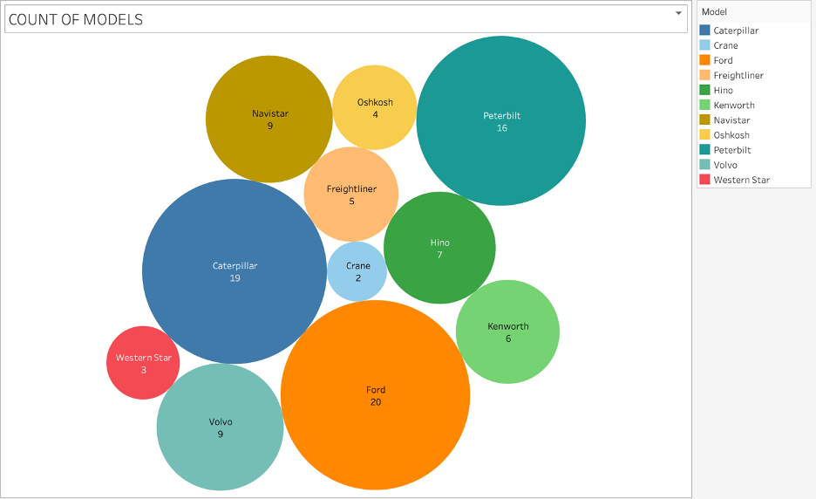
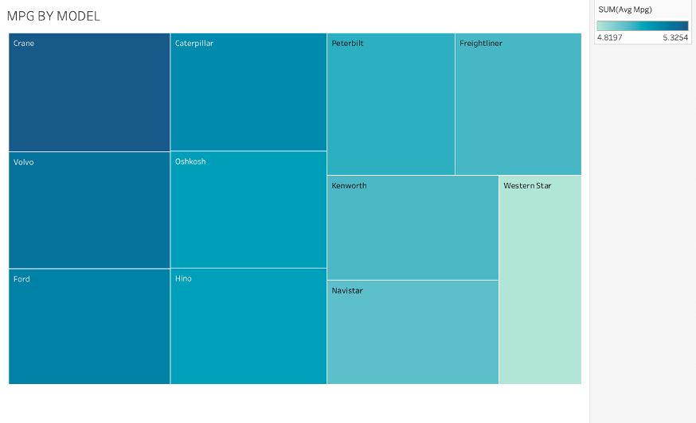
Count of Models (Bubble Chart)
Displays the number of vehicles for each model.
Larger bubbles represent a higher count of vehicles.
Ford has the largest bubble, indicating it has the most
MPG by Model (Heat Map)
Shows the miles per gallon for each vehicle model.
Darker shades represent higher MPG values.
Crane appears to have the highest MPG, as indicated by its dark shade.

Slide 6
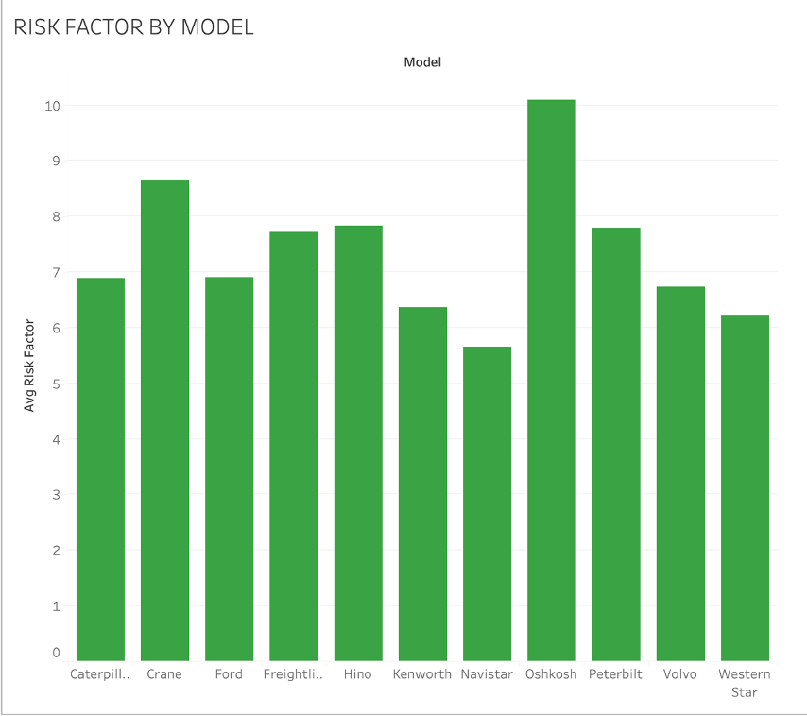
Risk Factor By Model (Bar Graph):
Depicts the risk factor associated with each vehicle model.
Oshkosh has the highest risk factor while Navistar has the least
The risk factors are relatively similar across models, ranging around 7 to just under 10.

Slide 7
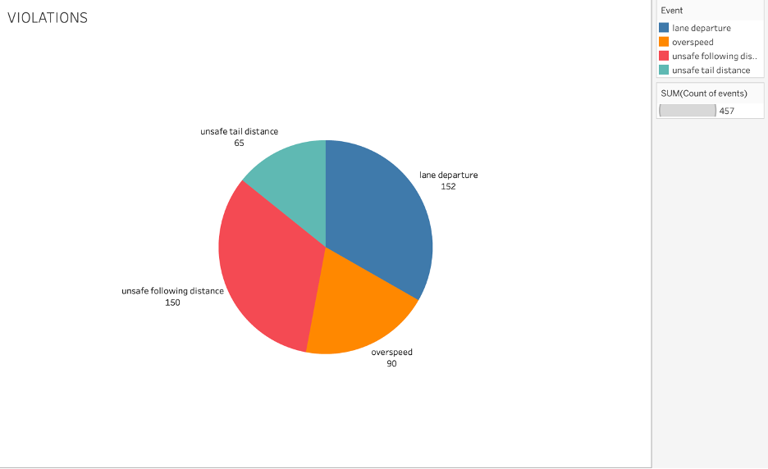
EVENT ANALYSIS
Lane Departure: The most frequent violation with 152 occurrences, indicating potential issues with driver attention or fatigue.
Unsafe Following Distance: Nearly as common, with 150 instances, pointing to risks of rear-end collisions due to inadequate spacing between vehicles.
Overspeed and Unsafe Tail Distance: Speeding is noted in 90 instances, a widespread issue, while unsafe tail distance, though less frequent at 65 cases, still poses a significant risk in poor driving conditions.
Recommendations:
Implement targeted driver training focusing on maintaining lane discipline and safe following distances.
Install in-vehicle monitoring systems to alert drivers of unsafe behaviors in real-time.
Analyze violation data to identify patterns and improve enforcement and awareness strategies.
Lorna Alvarado

Slide 8
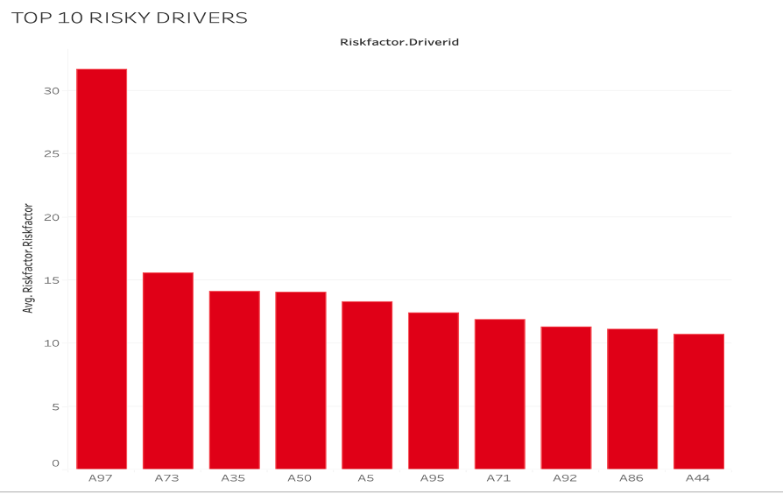
Top 10 Risky drivers

Slide 9
INSIGHTS:
High Risk Variability: Driver A97 exhibits a significantly higher risk factor, nearly double the next highest, indicating a unique risk profile.
Risk Clustering: A group of drivers (A35, A50, A5, A95) have similar, moderately high-risk factors, suggesting common risk characteristics or behaviors.
General Risk Levels: All top 10 drivers have risk factors above the critical threshold of 7.0, pointing to a need for risk management improvements.
RECOMMENDATIONS
Conduct an in-depth review of A97’s driving habits and possibly re-evaluate their role or provide specific training to mitigate risks.
Implement targeted training programs for drivers in the 10 to 12 risk factor range to address common risky behaviors.

Slide 10
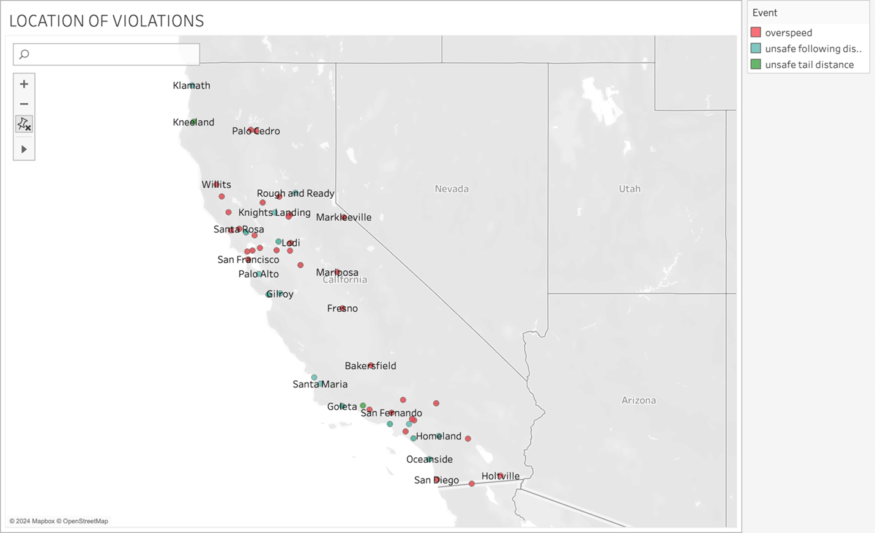
Insights:
Geographical Spread of Violations: Violations are widespread across California, with concentrations in urban areas like San Francisco and San Diego.
Types of Violations: The map indicates two main types of violations: overspeed and unsafe following distance, with unsafe following distance being less common.
Recommendations:
Increase monitoring and enforcement in urban areas where overspeed violations are more frequent.
Implement targeted driver safety campaigns focusing on the importance of maintaining safe speeds and following distances.

Slide 11
CONCLUSION
Data Analysis for Safety:
Utilize fleet data to identify high-risk drivers.
Implement targeted interventions to prevent accidents.
Financial and Reputational Protection:
Enhance safety measures to protect ANT’s financial and reputational standing.
Regulatory Compliance and Risk Management:
Adhere to industry regulations to enhance safety and compliance.
Continually improve risk management strategies to maintain competitiveness.

Slide 12
THANK YOU

